Slide 1
Modeling Cloud Ecosystems
Madiha H. Syed College of Electrical Engineering and Computer Science
Florida Atlantic University, Boca Raton, FL, USA
msyed2014@fau.edu

Slide 2
Outline
Introduction
Cloud Ecosystem
Recent Publications
Models of ecosystem components
Containers
Virtual Machine Environment
Conclusion

Slide 3
Introduction
Cloud computing offers demand-based computing service.
Levels of service: Infrastructure as a Service (IaaS), Platform as a Service (PaaS), and Software as a Service (SaaS).
A cloud is not a single system, it comprises a multitude of systems, components, services, and applications.
Clouds usually do not work in isolation but interact with other clouds and with a variety of associated and interdependent systems.
Associated systems are either developed by the same provider or by external entities with the purpose to interact with them.
Associated systems are a growing set, where new types of products appear.

Slide 4
Ecosystems
Ecosystems were initially defined from a biological perspective:
“systems formed by the interaction of a community of organisms with their physical environment”
The term was later applied to software systems:
“a collection of software systems, which are developed and co-evolve in the same environment”
An Ecosystem is the expansion of a software product line architecture to include systems outside the product which interact with the product.
Developing ecosystems for complex systems helps service providers as well as consumers.
Cloud computing is an excellent example of such complex interconnected systems.
Notes:
An ecosystem is advantageous to suppliers who can offer a larger variety of products or services, and to consumers who can find more products to help them reach their business goals

Slide 5
Cloud Ecosystem
A cloud, its associated systems, providers, consumers, brokers, software, and infrastructure are all related and make up the cloud ecosystem.
The complexity of the cloud ecosystem is also increasing as new functions or technologies become available.
Growth in dimension and diversity of this ecosystem is contributing to the evolution of intelligent and interactive environments like IoT.
All this can be of tremendous value but we need to properly handle this complexity in order to better utilize the full potential of the system.
Several companies are developing ecosystems around their products, e.g. Cisco, Apple, and Microsoft.
In cloud ecosystems their complementary systems may not be produced by the same vendor and may use different protocols although able to interact with other products in the ecosystem.

Slide 6
Motivation
Lack of reference architectures or other abstract models inhibit the wider adoption of software ecosystems and deny the possibility of exploiting their full potential
This need motivates our work:
Architectural models based on patterns are a powerful representation when building or using cloud ecosystems and similar complex systems
Despite the popularity of cloud there are major cloud challenges such as security, privacy and compliance.
Complex systems face serious security problems because of lack of holistic and unified view.
Systems built piecemeal overlook vital interactions that may lead to vulnerabilities
After a careful search we have not found similar models

Slide 7
What have we done so far?
We have the ecosystem in the form of a pattern diagram
Some of the components of this system have been already modeled as patterns and reference architectures using UML models, but some are missing
We added to the cloud ecosystem newly identified components, described as patterns.
We studied new types of systems, like IoT, which are driving the changes in cloud ecosystems.
We also discussed how this evolution is changing the way we handle software development and deployment.
We discuss the value of these models with respect to several security objectives.
We do not claim completeness, an ecosystem is open-ended and this model is a first step in their architectural representation.

Slide 8
Recent Publications
Madiha H. Syed and Eduardo B. Fernandez, “The Software Container pattern”, 22nd Conference on Pattern Languages of Programs (PLoP 2015), Pittsburgh, PA, October 24-26, 2015
Madiha H. Syed, E.B.Fernandez, M.Ilyas, “A pattern for fog computing”, Pattern Languages of Programming (VikingPLoP 2016), 7th-10th April 2016, Leerdam, Netherlands
Madiha H. Syed and E.B.Fernandez, “Cloud ecosystems support for Internet of Things and DevOps using patterns”, First International Workshop on Interoperability, Integration, and Interconnection of Internet of Things Systems (I4T), part of the IEEE Int. Conf. on Cloud Engineering (IC2E), Berlin, Germany, April 4-8, 2016.
E.B. Fernandez, Nobukazu Yoshioka, Hironori Washizaki, and Madiha H. Syed, “Modeling cloud ecosystems”, J. Future Internet 2016, 8, 13.
Madiha H. Syed and Eduardo B. Fernandez, “A Pattern for a Virtual Machine Environment”, 23rd Conference on Pattern Languages of Programs (PLoP 2016), Champaign, IL, October 23-26, 2016 (accepted)

Slide 9
Patterns and Reference Architectures
A pattern is a solution to a recurring problem in a specific context.
Patterns can be used to design and analyze complex systems, to capture design decisions, and to evaluate new or existing systems.
Patterns can also improve software quality by promoting reusability, scalability, and consistency.
They encapsulate the experience and knowledge of designers, provide a larger unit of reuse, and a communication vocabulary for designers.
Usually, a template with predefined sections is used to describe patterns.
POSA (Pattern-oriented software architecture) template.
A Reference Architecture (RA) is a standardized, generic software architecture, with no platform dependencies, valid for a particular domain.
An RA should define the fundamental components of a system and the interactions among these units.
An RA can be built of patterns and then be considered itself a pattern.
Notes:
A Reference Architecture (RA) is a generic and abstract software architecture that applies to a particular domain and does not contain implementation details.
It specifies the components of the system, their individual functionalities and their mutual interaction.
An RA can be considered as a compound pattern and its components described as patterns.

Slide 10
Pattern Sections
Intent (thumbnail) Every pattern starts with a thumbnail of the problem it solves and a brief description of how it solves the problem.
We define the context or environment where the pattern solution is applicable .
A problem section describes a problem and the forces that constrain and define guidelines for its solution.
Pattern solutions are usually described using modeling languages such as the Unified Modeling Language (UML), maybe combined with formal languages such as the Object Constraint Language (OCL). UML diagrams may include class, sequence, state, and activity diagrams.
A set of consequences indicate how the pattern solved the specific problem and what are the advantages and disadvantages of using it; i.e., how well the forces were satisfied by the solution.
An implementation section provides hints on how to use the pattern in an application.
A section on “known uses” lists real systems where this solution has been used previously, i.e., a pattern is an abstraction of a good practice.
A section on related patterns indicates patterns that complement or provide alternative solutions to the one in this pattern.

Slide 11
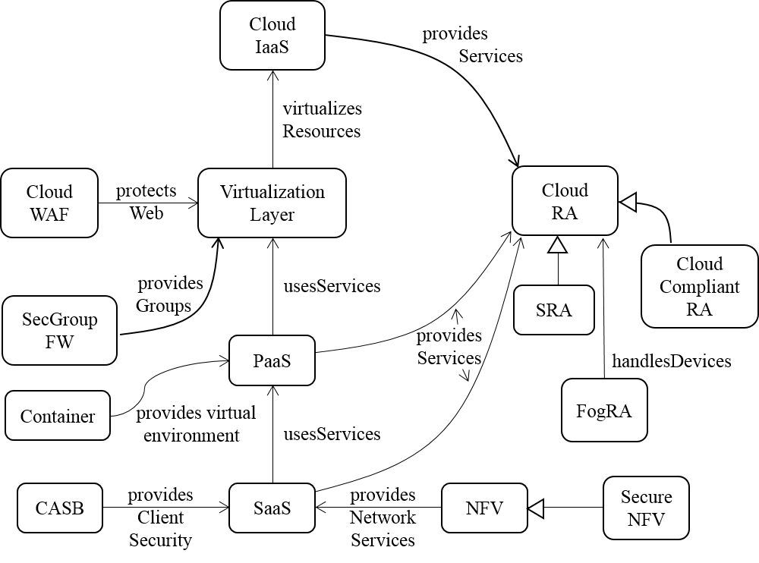
Pattern Diagram of Cloud Ecosystem
provides execution environment
Virtual Machine
Environment

Slide 12
EcoSystem Components
The core pattern of this ecosystem is the Cloud Reference Architecture (Cloud RA) .
Addition of security patterns to a Cloud RA converts it into a Cloud Security RA (Cloud SRA). The Cloud SRA includes security patterns for Authentication, Authorization, and Logging, among others, which can help control known threats to the cloud.
Patterns that describe how regulations apply to the Cloud RA are included in the Cloud Compliant RA
Other components of the ecosystem, shown in Figure, include the service layers of a cloud, IaaS, PaaS and SaaS .
Network Functions Virtualization (NFV) is a network architecture where network functions such as load balancers, firewalls, IDS, and accelerators are provisioned in software using virtualization.
Other security-related components are also represented as patterns.
Filtering functions are provided by Cloud Web Application Firewalls (Cloud WAF) and Security Group Firewalls (SecGroup FW).
Cloud Access Security Brokers (CASBs) are security enforcement points between consumers and service providers that apply security controls to access cloud services, usually SaaS services. They may also control access to internal company resources. Security controls may include authentication (credentials and passwords), authorization policy enforcement, intrusion prevention, antimalware filters, security logging/auditing, and encryption.
New entities that have been added to this ecosystem include Containers, Virtual Machine Environment and Fog Computing.
Notes:
Network Functions Virtualization (NFV) is an architecture for the construction of services using software building blocks that can be used to assemble network systems. The building blocks, Virtual Network Functions (VNFs), are created from cloud software services.
SOLUTION
Service providers (SPs) can use SaaS services to provide network functions where we simulate the specific functions of a hardware device using software running in one or more virtual machines or containers in the cloud. We can build network services using the PaaS and IaaS services and deploy them as SaaS services. These network services can then be used for the needs of the applications being accessed by the Consumers.

Slide 13
Value of Cloud ecosystems
Control heterogeneity
The involved components come from different vendors and follow a variety of standards and protocols. An abstract model can unify this heterogeneity and provide a way to understand and analyze global aspects of these systems.
Holistic and unified security view
Systems built piecemeal omit important interactions that may result in vulnerabilities.
An ecosystem provides such a holistic view by indicating the places where security mechanisms can be attached and their effect on the functional parts of the architecture.
We can extend the UML model of the functional ecosystem by indicating all the points where threats are neutralized with corresponding security patterns.
We can trace the propagation of attacks and study where to place defenses for greater effect.
Other quality factors: Holistic views are useful to combine quality factors such as safety or reliability with security.
Compliance with standards and regulations
Support for software development
Agile software development framework, DevOps which is enabled by cloud
Support for virtualization. It is possible to assign the software processes of the ecosystem to a variety of hardware platforms, some or all of which can be virtualized.
Support for service contracts. In an ecosystem users or institutions may want to rent services involving more than one product. This requires a service level agreement indicating the obligations ot providers and consumers. An ecosystem model can make these services transparent and indicate where compliance would be monitored.
Notes:
Analyzing security aspects of an ecosystem, use it to answer several security questions
Starting with security in fog controlling variety of devices
Lack of unified view can make integration of systems, each with its own security policies, very challenging
An RA can be used to support security standards and regulations, which can be described as policies which in turn can be implemented as patterns and made part of the SRA. Relating specific regulations to specific security mechanisms can be used to demonstrate compliance
Dereje Yimam and Eduardo B. Fernandez, “Building Compliance and Security Reference Architectures for cloud systems”, IEEE Int. Conf. On Cloud Engineering (IC2E) 2016, Berlin, April 4-8, 2016.
DevOps is an increasingly popular agile process to build software that relies heavily on containers.
Containers facilitate application distribution, especially for DevOps teams.
It calls for increased communication, collaboration and smooth integration between developers and operations teams. It enables continuous development and frequent releases of software to the end user, which can lead to earlier problem detection and solution delivery.
DevOps is driven by the wide availability of virtualized and cloud infrastructure.
For example, one can build a virtual drone implemented using two physical devices.

Slide 14
Models of Ecosystem Components
Software Containers
Virtual Machine Environment
Fog Computing
Notes:
-A pattern diagram for cloud ecosystem gives a holistic and unified view and the next step is to define detailed models for each of its components.
-Some of these components have already been described as patterns,
-here we include patterns for two components which were not present in our earlier work
-Complete patterns can be found in their respective references, just main functions of the components are included here.
Pattern descriptions also include Forces, Consequences, Implementation, and Related Patterns sections.
The idea here is that we can build patterns for every participant in the ecosystem, which provides a unified view of the complete system.

Slide 15
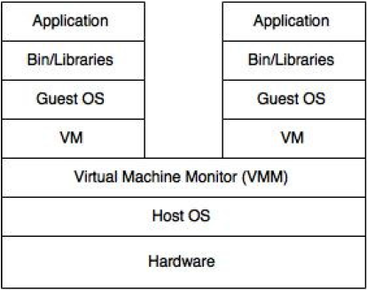
Software Container
Intent: A Software Container provides an execution environment for applications sharing a host OS, binaries, and libraries with other containers with strong isolation between them.
Containers are lightweight, portable, extensible, reliable, and secure.
Docker is a popular example of software containers.
Published in PATTERN LANGUAGES OF PROGRAMS (PLoP) 2015 conference in Pittsburgh, Pennsylvania
Figure 1. “Two containers sharing one OS” vs “A Virtual machine”

Slide 16
Software Container
Problem: We want to be able to run applications in self-contained environment in such a way that both (application and environment) can be treated as a single unit.
Solution: Provide a runtime environment that can support the isolated execution of applications on a shared Host OS, this is a Software Container.
Multiple applications can share one container.
They may share binaries and libraries with other containers.
Containers provide isolated execution and extensible services to the application.
Containers are lightweight, portable, reliable, and secure.

Slide 17
The Software Container Pattern
A Container controls a set of Applications sharing a Host OS that provides a set of Resources.
An Interceptor mediates the services provided to the application by the container.
Applications hosted in containers can be accessed remotely through Proxies, where the Container acts as a broker.
The client interacts with the Application Proxy, which represents the application.
The application interacts with the Client Proxy, which represents the client.
The Container provides a set of Services to the applications.
Figure 2. Class diagram of the Container pattern

Slide 18
Dynamics
Use case to execute an application in a container:
A remote client executes an application through its proxy.
The container transmits client requests to the Application through the Client Proxy.
In order to execute the request or access a resource, application issues an OS call.
This call goes to the interceptor before it is forwarded to Host OS.
Figure 3. Sequence diagram for the use case ‘Execute an application in container’

Slide 19
The Software Container Pattern
Known Uses:
Docker provides portable, lightweight containers, using Linux virtualization.
Cisco -- Cisco Virtual Application Container Services automate the provisioning of virtual private data centers and deploy applications with compliant, secure containers.
Rocket -- A product of CoreOS. This container attempts to be composable, secure, open format and runtime components, and simple discoverable images.
Containerization- useful practice in adopting DevOp approach
DevOps Patterns for Software Orchestration on Clouds (Sousa 2015)

Slide 20
Consequences
Advantages
Overhead: Containers are more efficient than VMs as they do not require separate guest OSs
Portability: Containers relieve developers & testers of application distribution worries.
Controlled Execution: Containers control and filter interactions with the Host OS.
Cost: Host OS is shared by multiple containers, no need to purchase separate licenses for Guest OSs on each VM.
Isolation: Containers provide isolation between applications running on same OS to protects other applications of attacks or errors in applications running in different containers.
Opaqueness: Applications running in separate Containers on same OS are not aware of each other, It can prevent attacks.
Transparency: specific environment becomes transparent to the application when executed within a container. Changes made to the OS or Application can be handled by container modification, without affecting other containers.
Scalability: number of applications sharing one OS can be increased if enough hardware resources are available.
Extensibility: Interceptors allow adding services such as logging/auditing, security, or others to an application.
Liabilities
Use of containers can slow down application execution due to additional layer of interceptors for indirection of messages between OS and application.
Containers provide isolation between applications, so task requiring collaboration between applications becomes more difficult if they are executing in separate containers.
We can only use one OS in each container. If we need different OS, we can use separate sets of containers or VMs.
Security or reliability flaws in the common OS affect all the applications running on it.

Slide 21
DevOps and Software Orchestration on Clouds
DevOps is a major change in Information System development.
A conceptual framework, comparable with Agile Software Development. (Erich 2014)
It reduces the gap between developers, operations and the end user --earlier problem detection.
DevOps enables continuous development and frequent releases of software to the end user.
It emphasizes on automating the process of software delivery and infrastructure changes
It enables having infrastructure automatically managed with code instead of people.
It is driven by wide availability of virtualized and cloud infrastructure
Software Containers help DevOp aware teams in isolation of services. (Sousa 2015)
Notes:
Software business is directing its growth towards service oriented business models highly supported by cloud computing
Orcestration in cloud consists on the process of creating and maintaining required infrastructure and services deployed on it
Devops achives these goals programatically

Slide 22
Virtual Machine Environment
Intent: Provide units of execution (virtual machines), which have access to virtualized hardware (processor, memory, and networks).
A VME creates and manages virtual machines according to user requests.
Accepted for publication in PATTERN LANGUAGES OF PROGRAMS (PLoP) 2016 conference in Champaign, Illinois
Context
Many companies and individuals need access to inexpensive processing power.
Many companies develop software intended to run in multiple hardware platforms
Notes:
VMs are not new, but their significance has increased tremendously with the use of clouds as a means to offer sharing of resources and providing inexpensive, on-demand, isolated units of execution.
A VME enables users to execute different types of operating systems and application stacks in each VM.
We present a pattern for a VME which describes benefits and liabilities of the VME.
Alternate solutions for portable and faster execution environments have appeared, like software containers, but still VMs continue to be the most versatile and flexible among the virtualization solutions.
Audience: designers and administrators of cloud systems or shared servers
Context
, where their software needs to be developed and tested.

Slide 23
Problem and Forces
How do we provide inexpensive computing power to many users?
Real processors can be purchased and used to host applications;
Its expensive and most resources go under-utilized.
Forces
Access to hardware features: Some applications may need access to a complete set of hardware features to support its execution.
Flexibility: we would like to run different types of OSs or systems software in each execution instance.
Isolation: There should be no way for a user in an execution environment to get access to the data or functions of another environment, either by error or intentionally. When an OS crashes or it is penetrated by a hacker, the effects of this situation should not propagate to other OSs in the same hardware.
Modularity: execution instances should have a well-defined interface to the software that will execute on them; this can improve interoperability.
Usability: Configuring an execution environment should be simple.
Portability: We want execution instances to be portable across hardware processors; that is, they should be able to be moved or copied from one processor to another processor without special handling.
Extensibility: It should be possible to dynamically provide additional services to the hosted applications like logging/auditing, filtering, persistence, and others.
Elasticity: It should be possible to dynamically increase or reduce the resources needed by an execution instance.
Notes:
The possible solution is constrained by the following forces:
1. Some applications may need access to a complete set of hardware features to support its execution.
2. : we would like to run different types of operating systems or systems software in each execution instance.
3: There should be no way for a user in an execution environment to get access to the data or functions of another environment, either by error or intentionally. When an OS crashes or it is penetrated by a hacker, the effects of this situation should not propagate to other OSs in the same hardware.
4. : execution instances should have a well-defined interface to the software that will execute on them; this can improve interoperability.
5. : Configuring an execution environment should be simple.
6: We want execution instances to be portable across hardware processors; that is, they should be able to be moved or copied from one processor to another processor without special handling.
7: It should be possible to dynamically provide additional services to the hosted applications like logging/auditing, filtering, persistence, and others.
8: It should be possible to dynamically increase or reduce the resources needed by an execution instance.

Slide 24
Solution
Create execution instances (processes) where application developers can think they are interacting with the real hardware
A virtualized processor with all the features of a hardware processor, Virtual Machine (VM)
The software or even the hardware can be chosen so as to support the application and optimize/improve a non-functional requirement.
A variety of software, e.g., databases, CAD/CAM, analytics packages, can be obtained from the Service Provider (SP) and loaded in the VM using a menu-like approach (Binaries/libraries).

Slide 25
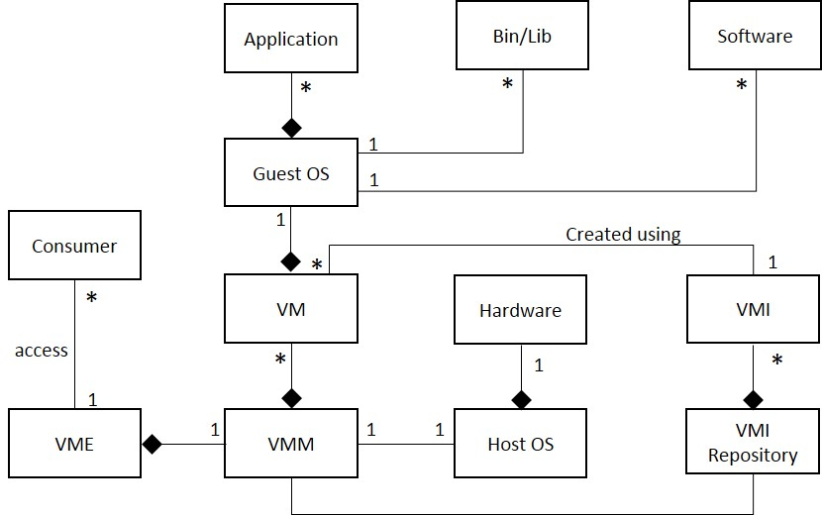
Structure
Consumer requests the VME to create a Virtual Machine (VM) and provides a list of required resources.
Each VM runs under the control of a Virtual Machine Monitor (VMM) (a.k.a Hypervisor), which provides a replica of all the features of some Hardware architecture.
A VMI Repository is a collection of VM image (VMI), which is a prepackaged software template used by VMM to instantiate a VM. It contains all the essential configurations files for VM creation.
We can run any type of Guest Operating System and Binaries/Libraries in each VM.
The diagram show a Host OS but this is not used in some implementations
Figure: Class diagram of a VM Environment

Slide 26
Final Objective for VM Creation
Build a VM with a set of selected software units
Size of memory, location, and other features can be also selected, as well as access control rules.
Notes:
The final objective for a user is to build a VM with a set of selected software units (Figure 3), typically an operating system, a DBMS, development tools, etc. The size of memory, location, and other features can be also selected, as well as access control rules. The sequence diagram of Figure 4 shows this use case.

Slide 27
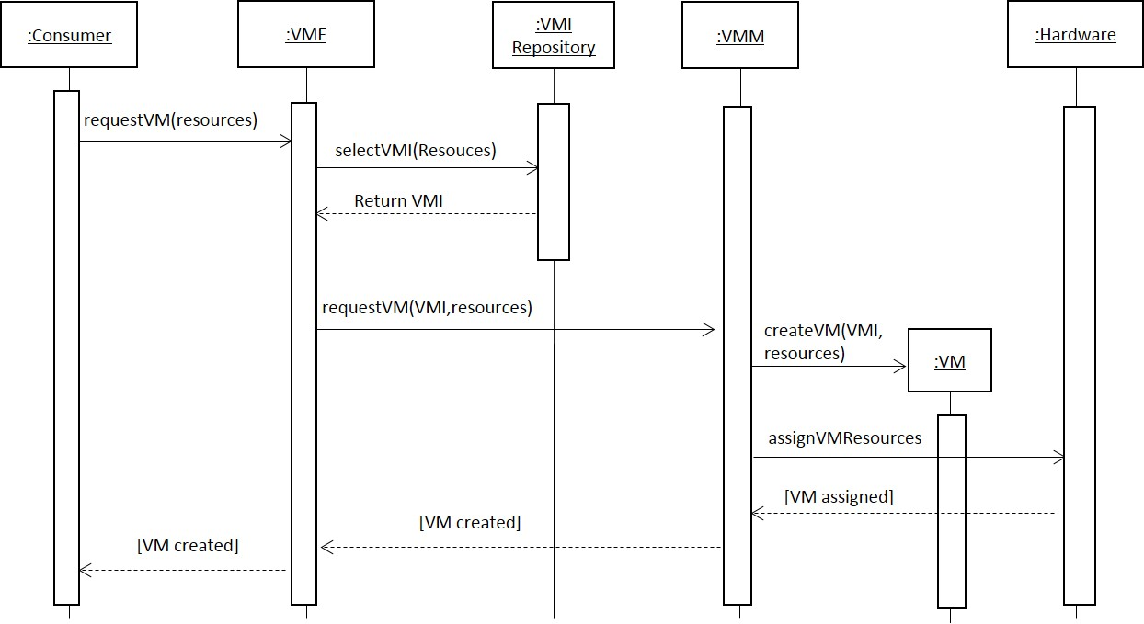
Dynamics
For the creation of a VM, a user can create a VM image with the required set of resources or select an existing VMI from VMI repository.
A consumer request VME for creating a virtual machine by providing a list of required resources.
VME selects a VMI from the repository based on consumer requirements.
The VMI repository provides the requested image.
The VME sends request to the VMM along with the VMI and list of resources to create a VM.
The VMM instantiate the VMI to creates a VM with the requested resources
The VMM assigns required hardware resources to the VM.
The VM is assigned to the consumer and acknowledgement is sent by VME to them that the VM has been created.
As a post-condition of this use case, a VM is created and assigned to a consumer account and to the required hardware.
Figure: Sequence diagram to Create a VM by a user
Notes:
For this use case, we assume that the user selects the already existing VMI from the repository.
A consumer selects a VMI from the repository based on required resources.
The VMI repository provides the requested image.
The consumer sends request to the VMM along with the VMI to create a VM.
The VMM instantiate the VMI to creates a VM with the requested resources
The VMM assigns required hardware resources to the VM.
The VM is assigned to the consumer and acknowledgement is sent to them that the VM has been created.
As a post-condition of this use case, a VM is created and assigned to a consumer account and to the required hardware.

Slide 28
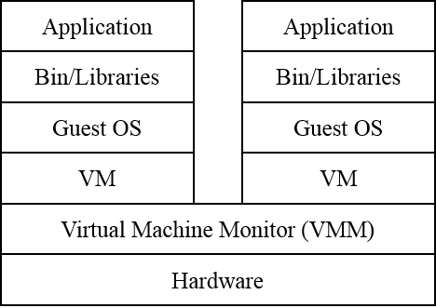
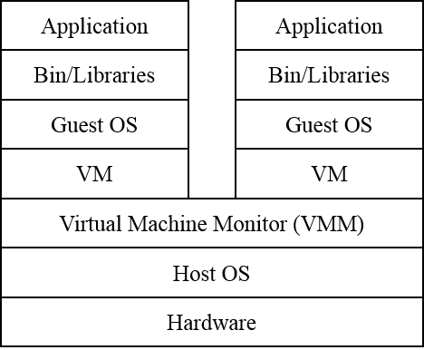
Implementation
VMs are created by a Virtual Machine Monitor (VMM).
VMMs can run on real hardware (bare metal VMM/Type 1 hypervisor) or on a host OS (Types 2 hypervisors).
In Type 2 VMM, I/O drivers of the guest OSs run in the Host OS.
This reduces memory needs and improves performance
It makes the virtual environment more complex =>more vulnerable to attacks.
Figure: Stack of the VM execution environment. Bare metal VMM and Hosted VMM respectively

Slide 29
Implementation
VMs can be created from Virtual Machine Images (VMIs) or in an ad hoc way by the user. VMIs are kept in a VMI Repository [Fer15].
VMIs load VMs with different amounts of storage, specific software, or other features.
Communication between VMs and users or external systems can be done using real or virtual networks.
Virtual networks can use physical devices (switches, routers) or can be virtualized functions (NFVs) [Fer15b].

Slide 30
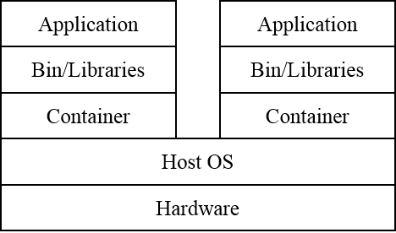
VM vs Containers
Containers operate with a lesser number of layers, a lightweight execution environment as compared to VMs.
Containers share the Host OS the resulting solution offers less flexibility
We can mix together in a cloud system VMs and containers.
Figure: The Stack for a Software Container
Notes:
flexibility (we cannot run together applications that need different operating systems).

Slide 31
Known uses
IBM VM/370 [Cre81]. This was the first VMOS, it provided VMs for an IBM370 mainframe.
VMware [Nie00]. This is a commercial company that provides VMs for Intel x86 hardware.
QEMU (Quick Emulator) is an open-source VMM which runs on x86 systems [Qem16]. It can be run as a pure emulator or native VM.
Xen is a VMM for the Intel x86 developed as a project at the University of Cambridge, UK [Bar00].
VirtualBox is a free and open-source VMM from Oracle for x86 hardware. [Vir16].
Some smart phone operating systems use a few specialized VMs to separate the user’s private system from her work environment. These include the L4 Microvisor [Hei10] and RIM’s Black Berry 10 OS [Bla16].

Slide 32
Consequences
Access to hardware features: Each operating system or other system software has access to a complete set of hardware features to support its execution. Not all users may require this type of access.
Flexibility: we can run different types of operating systems or systems software in each VM.
Isolation: The VMM intercepts and checks all system calls. The VMM is in effect a Reference Monitor and provides total mediation on the use of the hardware. This can provide a strong isolation between virtual machines [Ros05].
Modularity: execution instances can have standards for their interface to the software that will execute on them; infact, there is already an standard for this interface [OVF].
Usability: Configuring an execution environment requires only to select software packages from a menu.
Portability: We can move a VM from one processor to another by just moving its process descriptor. We can also replicate VMs in this way to provide fault tolerance.
Extensibility: It is possible to dynamically provide additional services.
Elasticity: The SP has tools to dynamically increase or reduce the resources needed by a VM.
Notes:
The Virtual Machine Pattern has the following advantages:
[OVF] https://en.wikipedia.org/wiki/Open_Virtualization_Format

Slide 33
Liabilities
A time overhead compared to running on a real processor.
Some time and complexity overhead compared to containers.
A need to control the use of VMs for which we need an administration structure

Slide 34
Related patterns
Container [Sye15]. A Software Container provides an execution environment for applications sharing a host operating system, binaries, and libraries with other containers. Containers have less execution overhead but are less flexible than VMs.
Reference Monitor. As indicated, the VMM includes a concrete version of a Reference Monitor [Fer13a].
Cloud Security Reference Architecture [Fer15].
NFV [Fer15b]. Network Functions Virtualization (NFV) is an architecture for the construction of network services using software building blocks. The building blocks, Virtual Network Functions (VNFs), are typically created from cloud services using virtual machines or containers.
Secure Virtual Machine Image Repository [Fer13b]: Avoid the poisoning of VM images during creation and the leaking sensitive information accidentally left in the VMI by enforcing access control to the repository.
Cloud Policy Management Point [Fer13b]: Provide an administrative dashboard for security functions, including authentication, authorization, cryptography, logging, and control of VM images.

Slide 35
references
E.B.Fernandez, “Security patterns in practice: Building secure architectures using software patterns”, Wiley Series on Software Design Patterns, 2013 (Chapter 15 describes cloud architectures)
E.B.Fernandez, Raul Monge, and Keiko Hashizume, “Building a security reference architecture for cloud systems”, Requirements Engineering. Doi: 10.1007/s00766-014-0218-7, 2015
E.B. Fernandez, N. Yoshioka, and H. Washizaki, “Patterns for Security and Privacy in Cloud Ecosystems”, 23rd IEEE Int. Requirements Eng. Conf., August 24-28, Ottawa, Canada
E. Fernandez and Brahim Hamid, “A pattern for Network Functions Virtualization”, 21st European Conf. on Pattern Languages of Programs (EuroPLoP 2015)
E.B. Fernandez, Nobukazu Yoshioka, Hironori Washizaki, “Cloud Access Security Broker (CASB): A pattern for accessing secure cloud services”, Procs. of 4th AsianPLoP (Pattern Languages of Programs) 2015, Tokyo, Japan, March 2015.
E.B.Fernandez, H. Yashizaki, N. Yoshioka, “Patterns for Secure Cloud IaaS”, 5th Asian Conference on Pattern Languages of Programs” (AsianPLoP 2016).
Dereje Yimam and Eduardo B. Fernandez, “Building Compliance and Security Reference Architectures for cloud systems”, IEEE Int. Conf. On Cloud Engineering (IC2E) 2016, Berlin, April 4-8, 2016.
Madiha H. Syed and Eduardo B. Fernandez, “The Software Container pattern”, 22nd Conference on Pattern Languages of Programs (PLoP 2015), Pittsburgh, PA, October 24-26, 2015
Madiha H. Syed, E.B.Fernandez, M.Ilyas, “A pattern for fog computing”, Pattern Languages of Programming (VikingPLoP 2016), 7th-10th April 2016, Leerdam, Netherlands
Madiha H. Syed and E.B.Fernandez, “Cloud ecosystems support for Internet of Things and DevOps using patterns”, First International Workshop on Interoperability, Integration, and Interconnection of Internet of Things Systems (I4T), part of the IEEE Int. Conf. on Cloud Engineering (IC2E), Berlin, Germany, April 4-8, 2016.
E.B. Fernandez, Nobukazu Yoshioka, Hironori Washizaki, and Madiha H. Syed, “Modeling cloud ecosystems”, J. Future Internet 2016, 8, 13.
Madiha H. Syed and Eduardo B. Fernandez, “A Pattern for a Virtual Machine Environment”, 23rd Conference on Pattern Languages of Programs (PLoP 2016), Champaign, IL, October 23-26, 2016 (accepted)

